Slide 1

Stars and Quality
  Robin Esparza, LVN
  Senior Stars Improvement Professional
  resparza1@humana.com

Slide 2



Humana STARS Provider Spot Bonus Program
We are excited to announce a new bonus program launching this Summer
in partnership with Payspan Health. For selected measures you can earn
$100 for each care gap opportunity addressed.
The program begins 8/1/2020 Open opportunities addressed for the measures
below through 12/31/2020 will qualify for the $100 bonus.
STARS Provider Spot Bonus Program measures:
Breast Cancer Screening-can be discussed/scheduled through telehealth
Care of older Adults Medication Review-can satisfy via telehealth
Care of older Adults Pain Screening-can satisfy via telehealth
Osteoporosis Management in Women who have had a Fracture-can discuss/prescribe via telehealth
Rheumatoid Arthritis Management-can discuss/prescribe via telehealth
Statin Therapy for Patients with Cardiovascular Disease-can discuss/prescribe via telehealth
Statin Use in Persons with Diabetes-can discuss/prescribe via telehealth

Slide 3


Humana STARS Provider Spot Bonus Program
Payspan will contact your office’s authorized administrator to ensure your practice’s payment is accurate as well as to assist with questions related to the Payspan portal.
Humana will confirm addressed opportunities via processed claims and supplemental data submitted by the practice.
Bonus payments will be accumulated and sent each month per the practice’s payment information in the Payspan portal.
Through the Payspan portal you will have the ability to view the current open care opportunities, closed care opportunities and payments received.
Once a gap is closed, the payment will be added to the following months payment schedule.

Slide 4
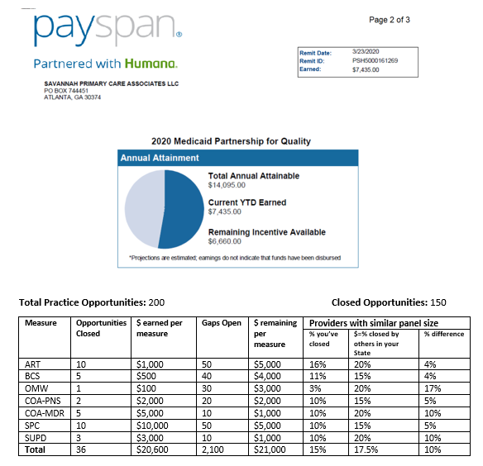
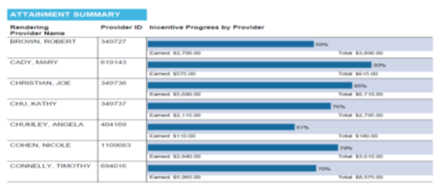
Humana STARS Provider Spot Bonus Program
Provider Experience
Member Level Gap Reporting in Payspan
Providers will receive a weekly digital document that details:
Open gaps, compliance rates, and bonus opportunity by member
Measure level gap reporting and compliance rates by provider
Total potential bonus opportunity, amount earned to date, and amount still available
Metrics on how provider’s compliance rates performance compared to similar providers in their state

Slide 5
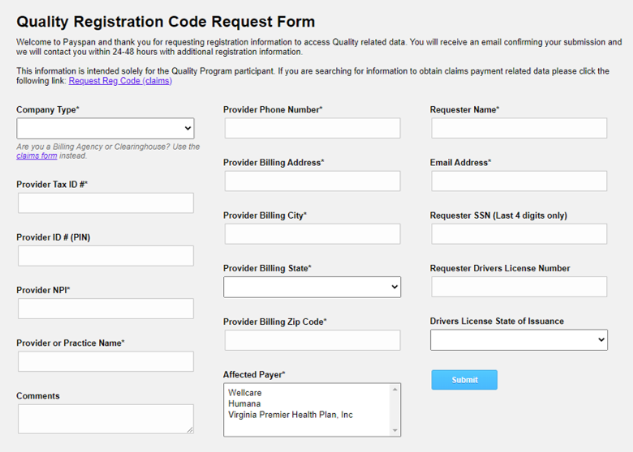
Provider Spot Bonus Program
How do providers register for Payspan?
  Providers have to sign-up on the Payspan portal. The first step requires providers to fill out a screen that looks like the one below. Once this is filled out, you will get a registration code that officially registers you for the program. Once the TIN is registered you have to confirm all of the NPIs associated with the TIN. These steps are all in an effort to maintain security of PHI and PFI, and to reduce the risk of fraud.

